Slide 1
Data-Driven Behavioral Analytics with Networks
Meng Jiang
www.meng-jiang.com
Job talk at [University]
Notes:
[University]

Slide 2
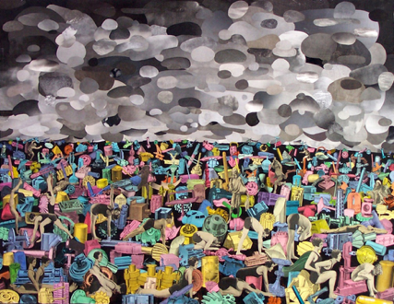
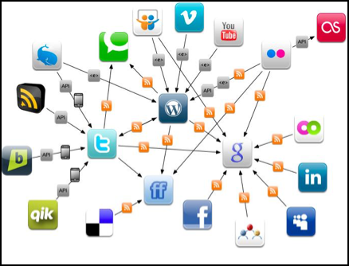
What is Behavior (Analysis)?
Definition. Interactions made by individuals in conjunction with themselves or their environment. (Wikipedia)
Significance. What can we discover from behavioral data?
Ex. Given every phone call/message between military leaders, scientists, businesspersons, find…
Today. The human behaviors are broadly recorded in an unprecedented level. Insights of sciences and society?
Physical World
Online Applications

Slide 5
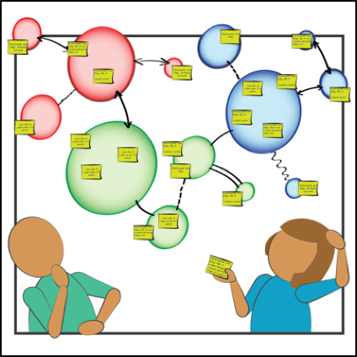
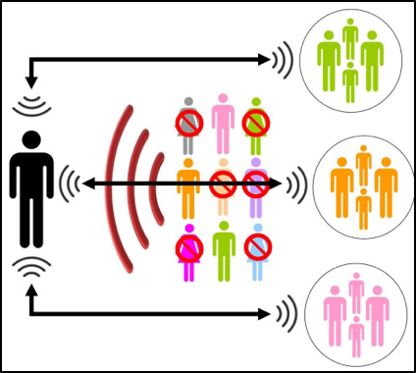
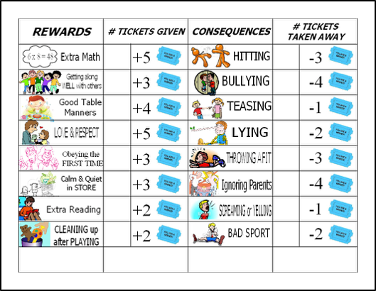
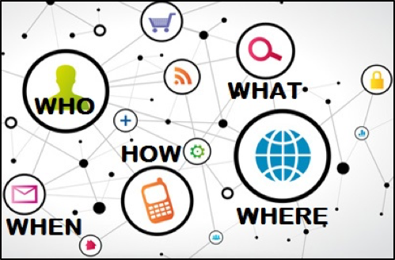
Challenges in Behavioral Analysis
Content
(preference)
Social context
(influence)
Behavioral Analysis
Spatiotemporal context
Intention
(suspiciousness)

Slide 6



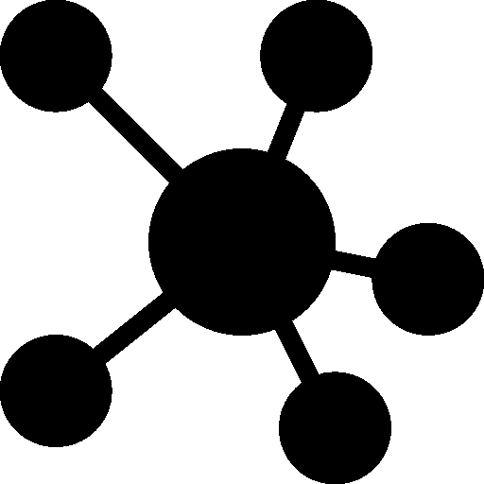



Methodology: Why Data-Driven?
Experience-Driven
Data-Driven
Applications. Recommender systems, fraud/spam detection.
Representation. Behavior Network for interaction.
Nodes: users/authors, items (e.g., products, tweets, papers), etc.
Links: (interaction) following, purchasing, tweeting, publishing, etc.
Node attributes: user profiles, item properties/features, etc.
Link attributes: similarity, distance, weight, etc.
Observation
Representation
Models/Algorithms

Slide 7
The 1st Day I Became a Data Mining Person
April 20, 2011: Tencent Weibo visited Tsinghua University
Low conversion rate (< 6%): #retweets per feed request
Can we build a tweet/item recommender system?
Given
Predict which tweet/item a user will retweet.
Content similarity
(topic level) [Blei et al.]
User-item behavior network
User-user social network
i
sender
u
i
0.1
send
u
u
i
u
i
0.9
0.7
receive
u
i
receiver
i
u
i
u

Slide 8






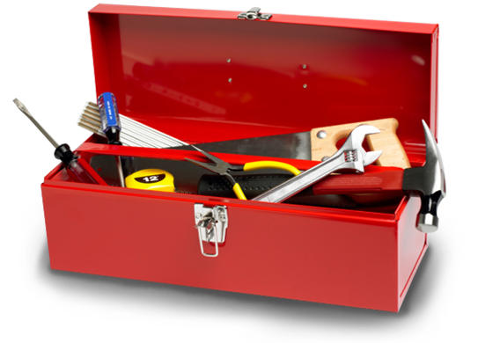




Roadmap
Toolbox
Data-Driven Behavioral Analytics with Networks

Slide 9
Roadmap
Toolbox
Behavior prediction

Slide 10
Related Work
Q: What are the factors of users’ decisions on retweeting? Can we observe them from the data? How to integrate the information for accurate prediction?
 | Behavior | Content | Social | Trust
Collaborative filtering (CF) [Herlocker et al. TOIS; Koren KDD] | ✔
Content-based filtering with CF [Balabanovic et al.; Liu et al. CIKM;] | ✔ | ✔
SoRec [Ma et al. CIKM, TIS] SoReg [Ma et al. WSDM] | ✔ |  | ✔
Trust-based methods [Massa et al. RecSys; Jamali et al. KDD; Ma et al. SIGIR, TIST] | ✔ |  |  | ✔

Slide 11
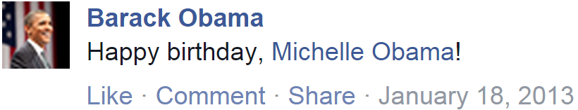
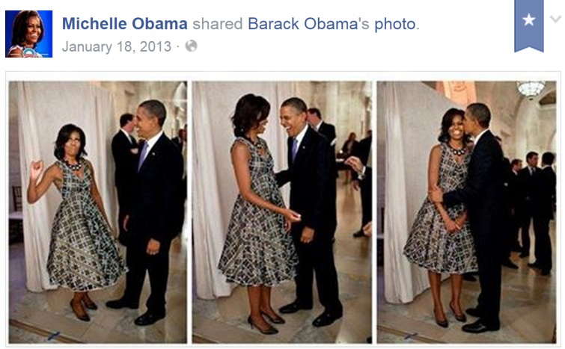
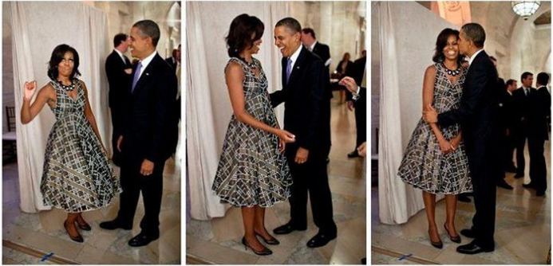
Social Contextual Factors
Will Michelle Obama share this message?
Please list your reasons.

Slide 12
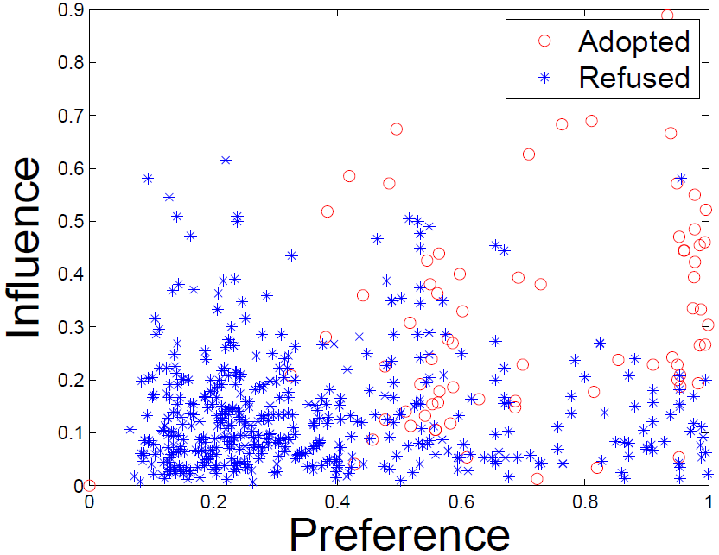
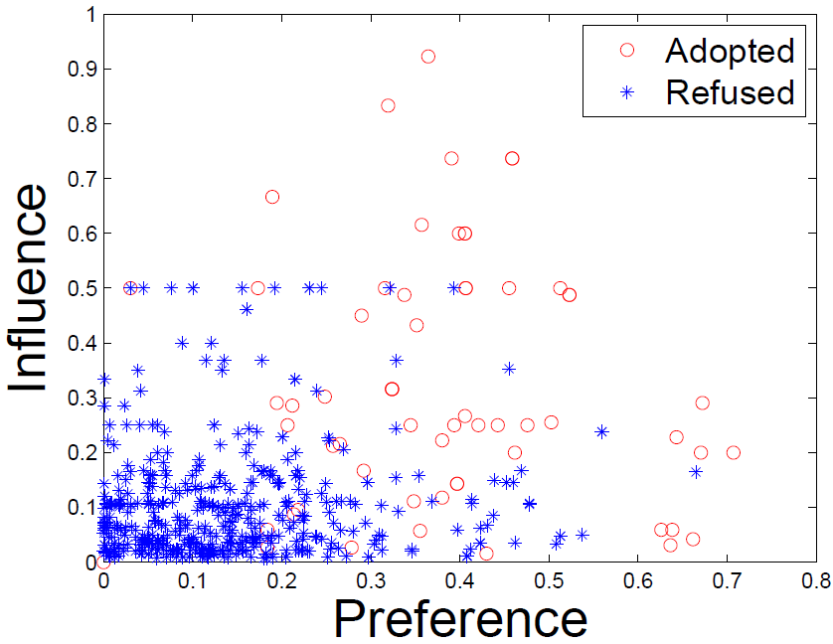
Social Contextual Factors
u
send
i
u
send
i
×
receive and retweet
receive but ignore
u
u
adopted
refused
↗
↗
China’s Facebook: Renren
China’s Twitter: Tencent Weibo

Slide 13
Modeling: From Contextual Information to Contextual Factors
Content
Item-item similarity
Item latent features V
Personal preference
on the given item
Behavior
User-item interaction
User latent features U
Social
User-user social relation
Item sender G
Interpersonal influence
from the item’s sender
Interaction frequency
User-user interaction
User-user influence S

Slide 14
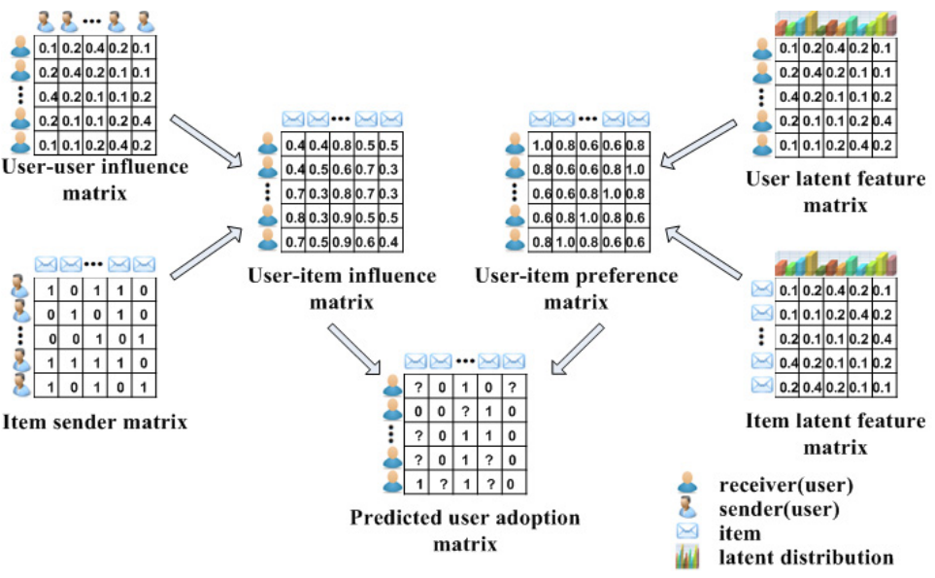
ContextMF
S
U
G
V

Slide 15
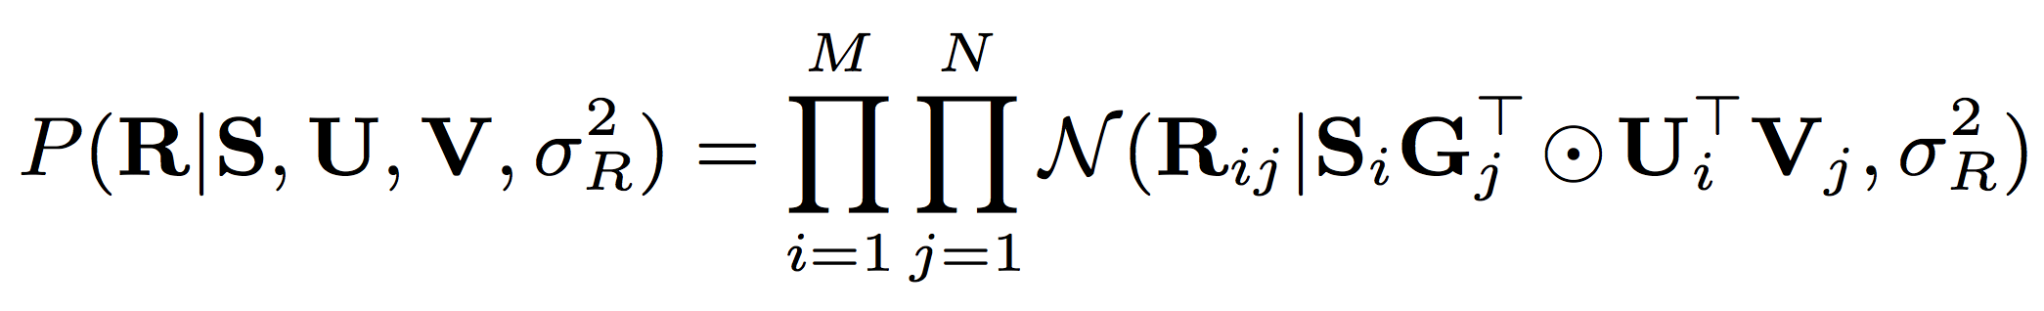
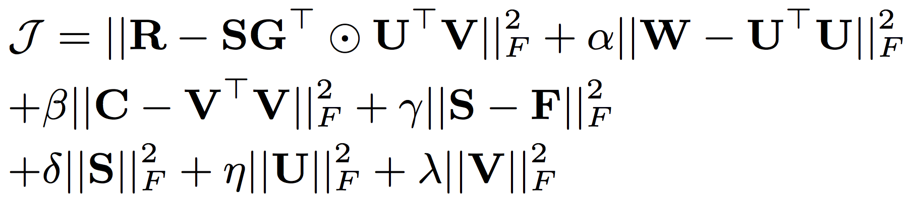
ContextMF
behavior
influence
preference
behavior
interaction frequency/trust
item content
social relation

Slide 16
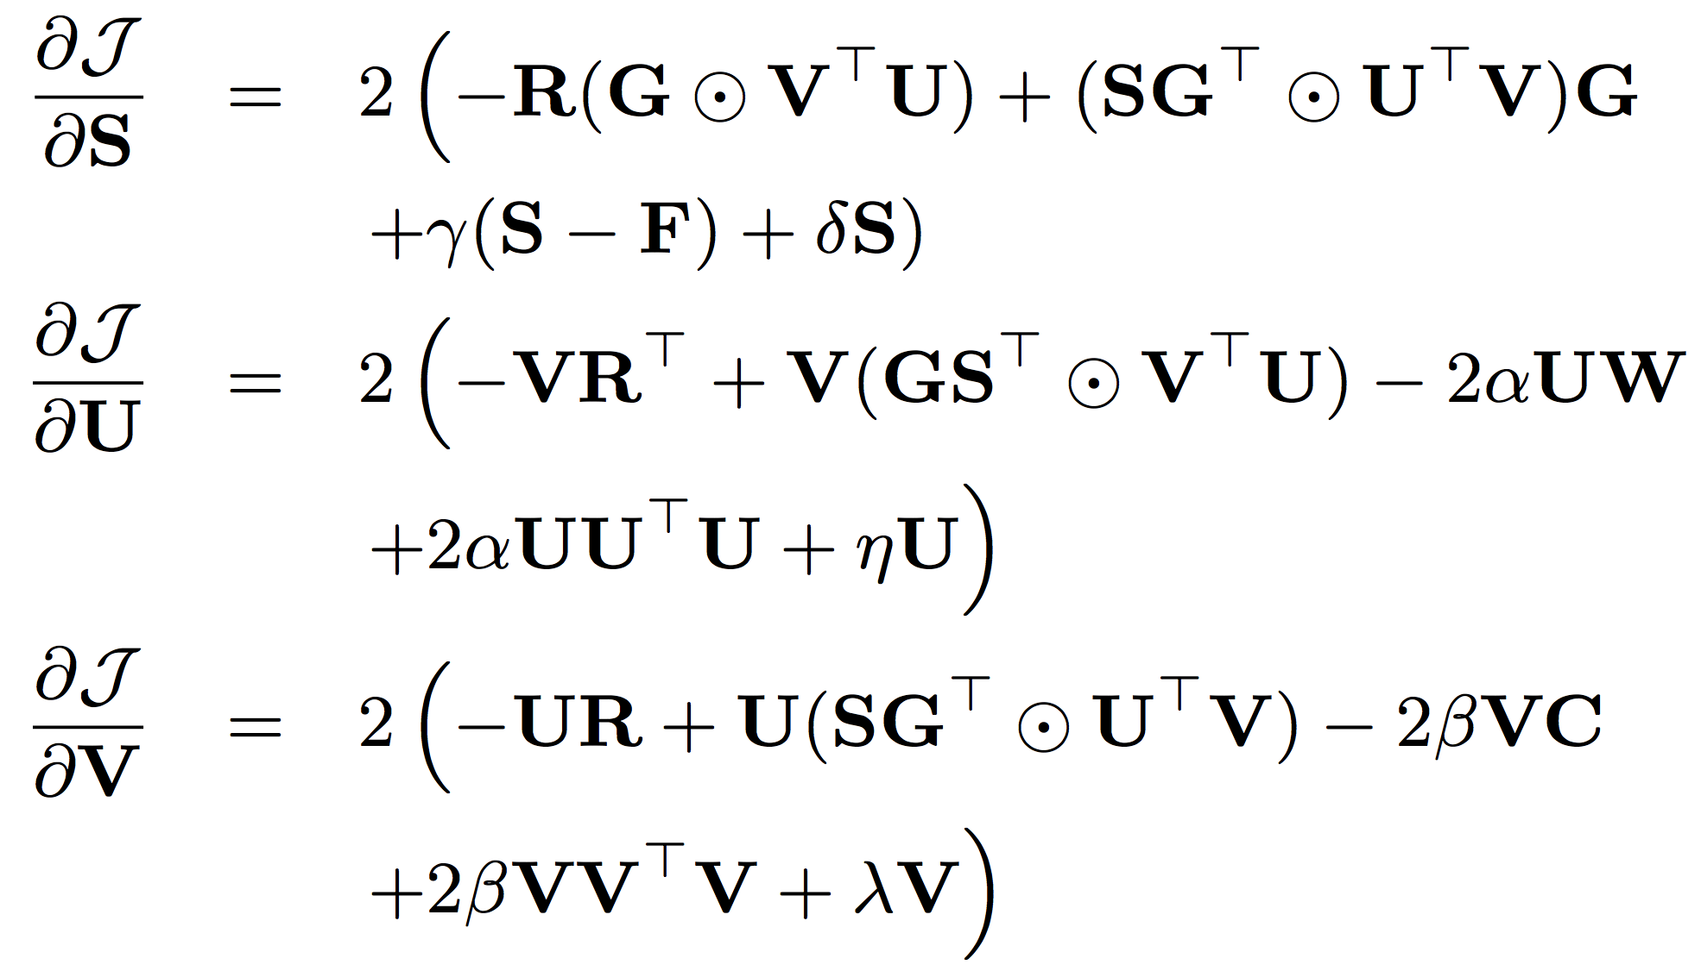
ContextMF
Gradient descent method

Slide 17
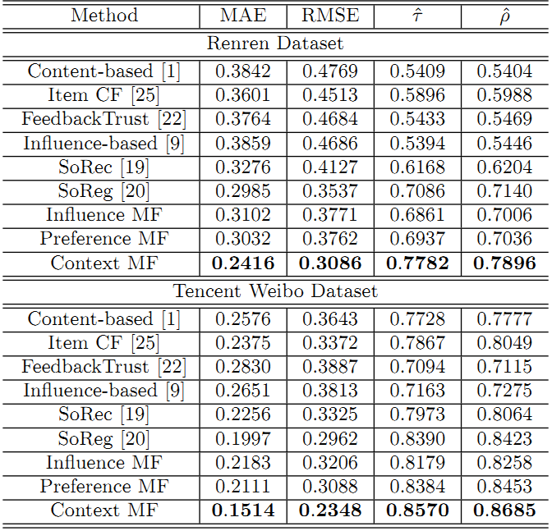
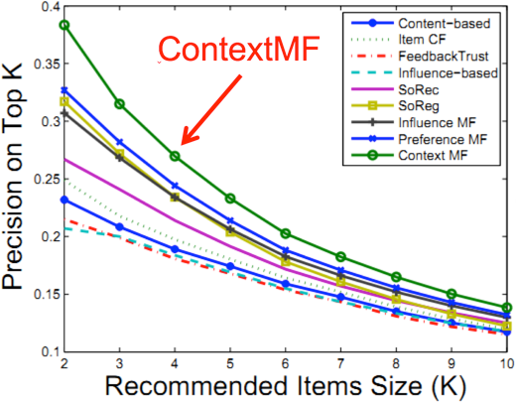
Experimental Results
vs. SoReg [TIST’11] | Renren | Tencent Weibo
MAE | ↓19.1% | ↓24.2%
RMSE | ↓12.8% | ↓20.7%
Kendall’s | ↑9.82% | ↑2.1%
Spearman’s | ↑10.6% | ↑3.1%
Prediction@K

Slide 18
Impact
Deployed in Weibo News Feed. Improved conversion rate from 5.78% to 8.27% (relatively 43%).
M. Jiang, P. Cui, R. Liu, Q. Yang, F. Wang, W. Zhu and S. Yang. “Social Contextual Recommendation” in CIKM’12.
Published in TKDE’14 after added the scalability feature.
#citations = 116 + 33 = 149
Can we transfer knowledge across domains/platforms?
Cross-domain behavior modeling. CIKM’12, TKDE’15.
#citations = 44 + 8 = 52
Cross-platform behavior modeling. AAAI’16.
Notes:
[116] [33] [149] [44] [8] [52]

Slide 19
Roadmap
Toolbox
Behavior prediction
Matrix factorization
Collaborative filtering
Gradient descent
Random walk with Restarts
Semi-supervised learning
Transfer learning

Slide 20

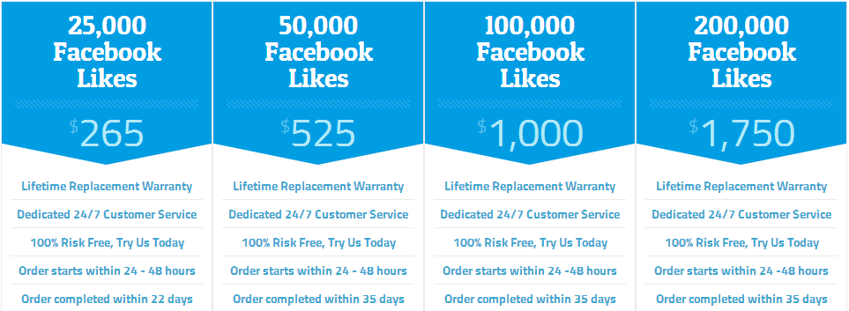
A More Serious Problem in Weibo
×
Experience-driven approaches: features of #followees, #hashtags, #URLs…

Slide 21
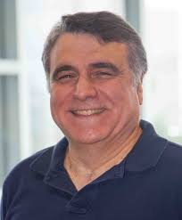
Roadmap
Toolbox
Behavior prediction
Visited Prof. Christos Faloutsos (CMU) from Aug 2012 to May 2013
Suspicious behavior detection

Slide 22
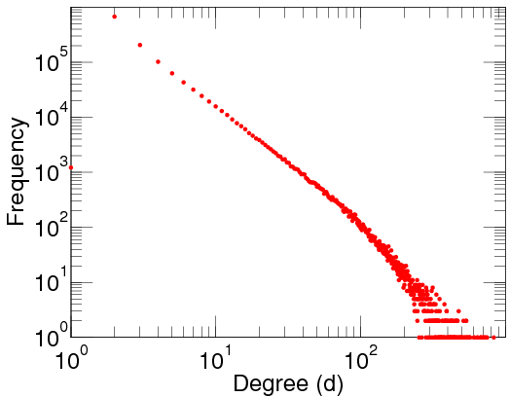
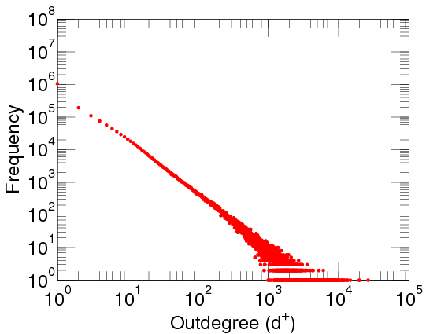
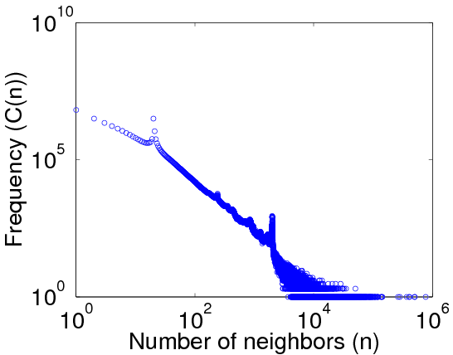
Out-Degree Distributions
Power-law distribution [Faloutsos et al. SIGCOMM; Broder et al. Computer Networks; Chung et al. PNAS]
DBLP Author-publication | Flickr User-user | Twitter Who-follows-whom
[konect.uni-koblenz.de/networks/]

Slide 23


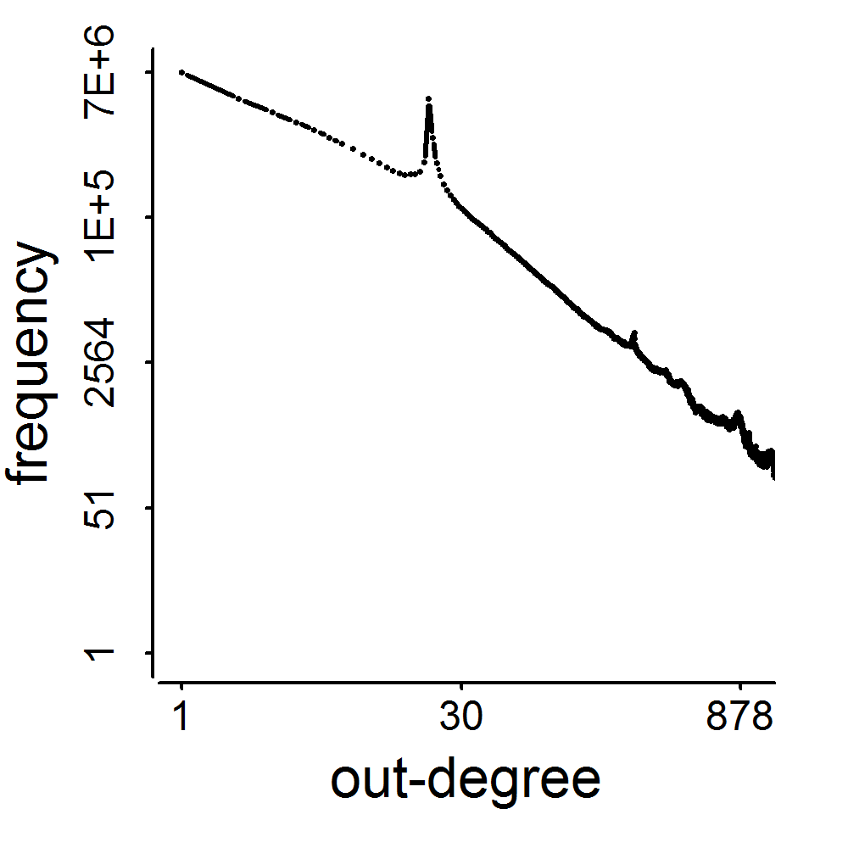
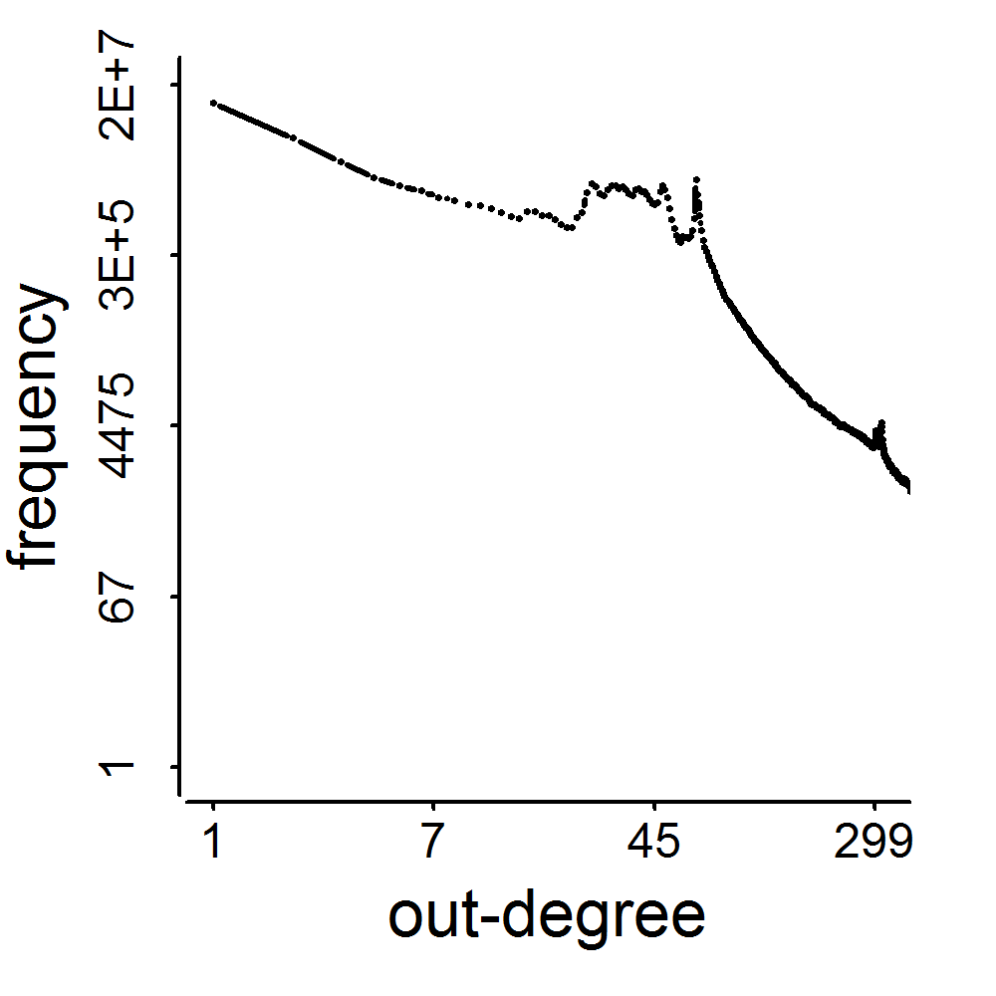
Spikes!
2009
41M
2011
117M
3.17M
1.91M
0.41M
0.44M
d=20
d=64

Slide 24
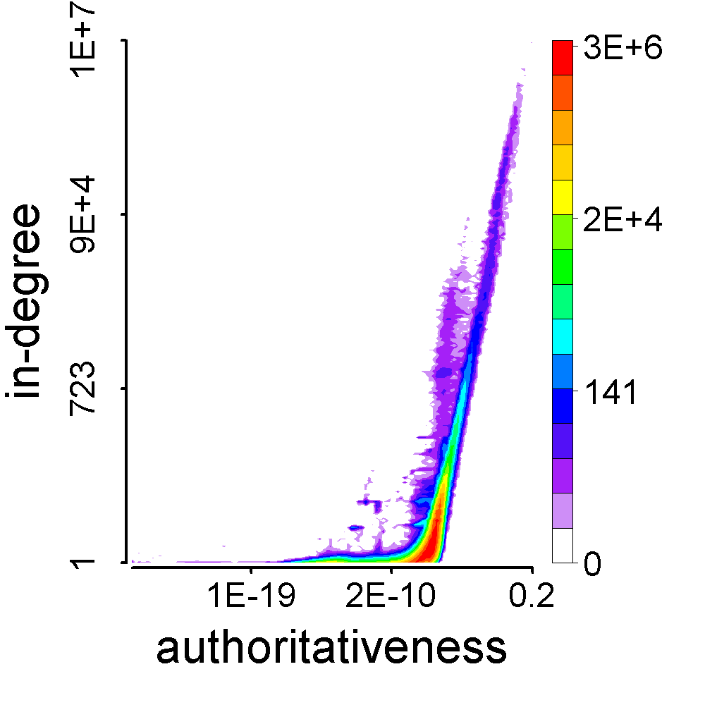
Observation: How They Behave
Feature space of followees [Kleinberg. JACM]
President Barack Obama
Meng Jiang

Slide 25
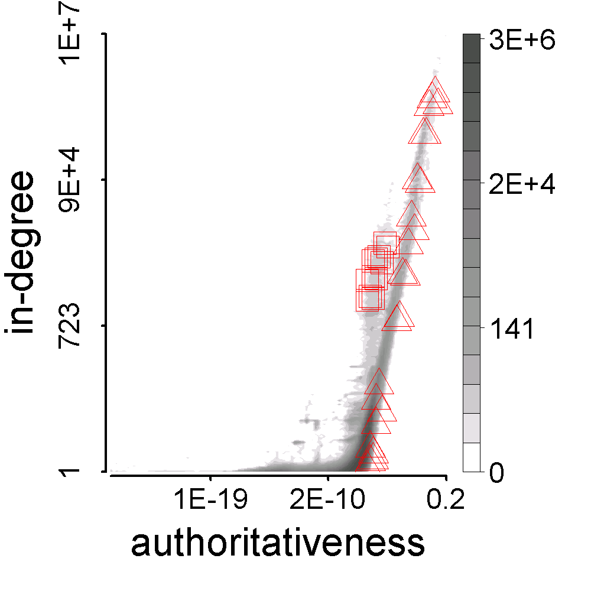
Observation: How They Behave
Who are their followees?
Their behavioral pattern
Synchronized
Similar with each other
Abnormal
Different from the majority
Meng Jiang
#followee=117
BuyAB22
#followee=20

Slide 26
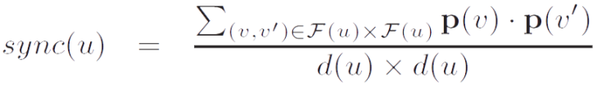
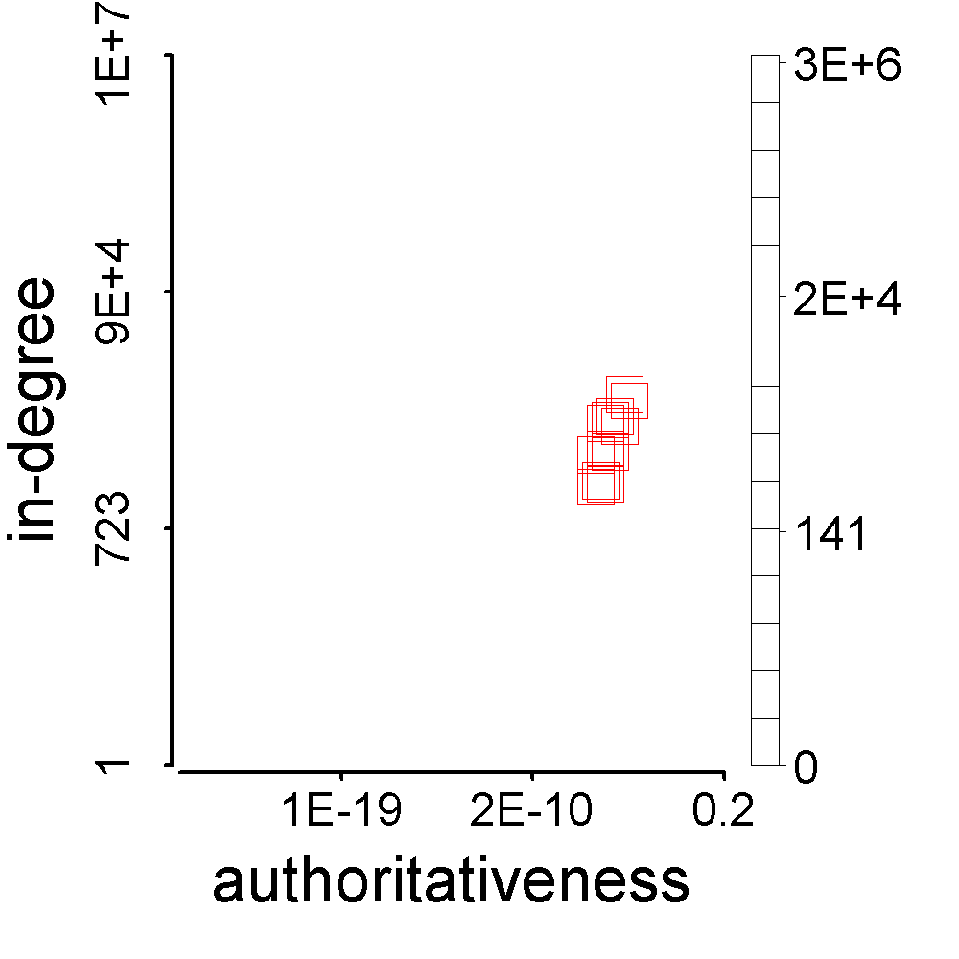
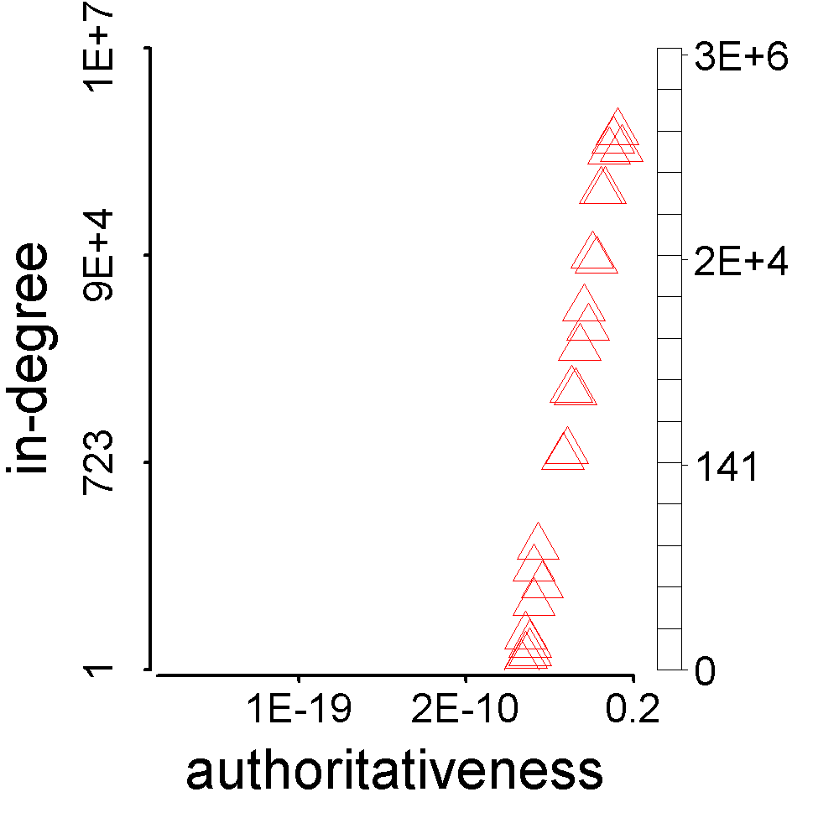
Represent Synchronicity
>

Slide 27
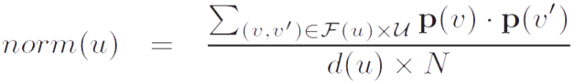
Represent Normality
<

Slide 28

Theorem: Synchronicity vs. Normality
G grids
fp_{g}: #foreground points in grid g
∑fp_{g} = F = d(u) (#followees of u)
Given normality
n = ∑(fp_{g}/F) (bp_{g}/B) = ∑f_{g}b_{g},
find minimal synchronicity
s = ∑(fp_{g}/F) (fp_{g}/F) = ∑f_{g}²
where
∑f_{g} = 1, ∑b_{g} = 1
bp_{g}: #background points in grid g
∑bp_{g} = B = N (#all users)

Slide 29
Theorem: Synchronicity vs. Normality
G grids
Solution.
Lagrange multiplier:
minimize s(f_{g}) = ∑f_{g}²
subject to ∑f_{g} = 1, ∑f_{g}b_{g} = n
Lagrange function:
F(f_{g}, λ, μ) = (∑f_{g}²) + λ(∑f_{g} – 1) + μ(∑f_{g}b_{g} – n)
Gradients:
▽f_{g}F = 2 f_{g} + λ + μ b_{g} = 0
▽λF = ∑f_{g} – 1 = 0
▽μF = ∑f_{g}b_{g} – n = 0
2 + λ G + μ = 0
2 n + λ + μ s_{b} = 0
2 s_{min} + λ + μ n = 0
where s_{b} = ∑b_{g}².
Therefore,
– G n² + 2 n – s_{b}
1 – G s_{b}
∑
× b_{g} ∑
× f_{g} ∑
s_{min} =

Slide 30
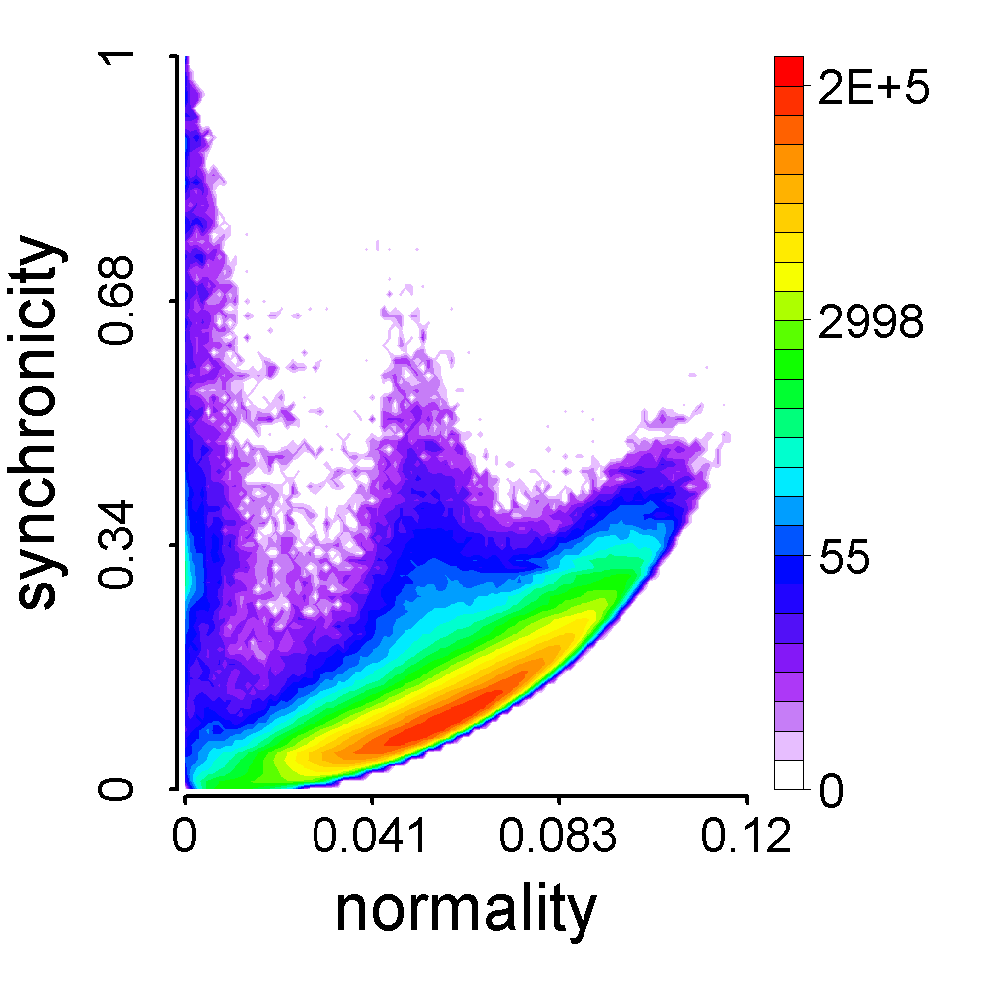
CatchSync
G grids
– G n² + 2 n – s_{b}
1 – G s_{b}
s_{min} =
BuyAB22
Meng
Jiang

Slide 31
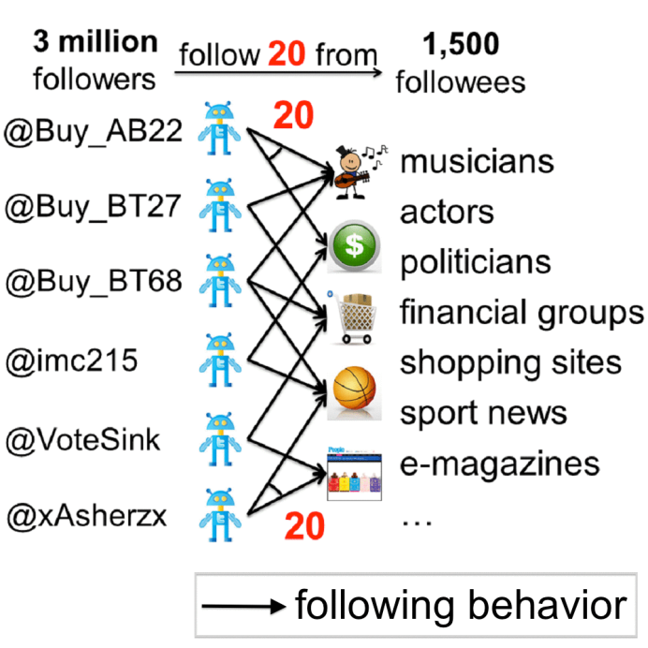
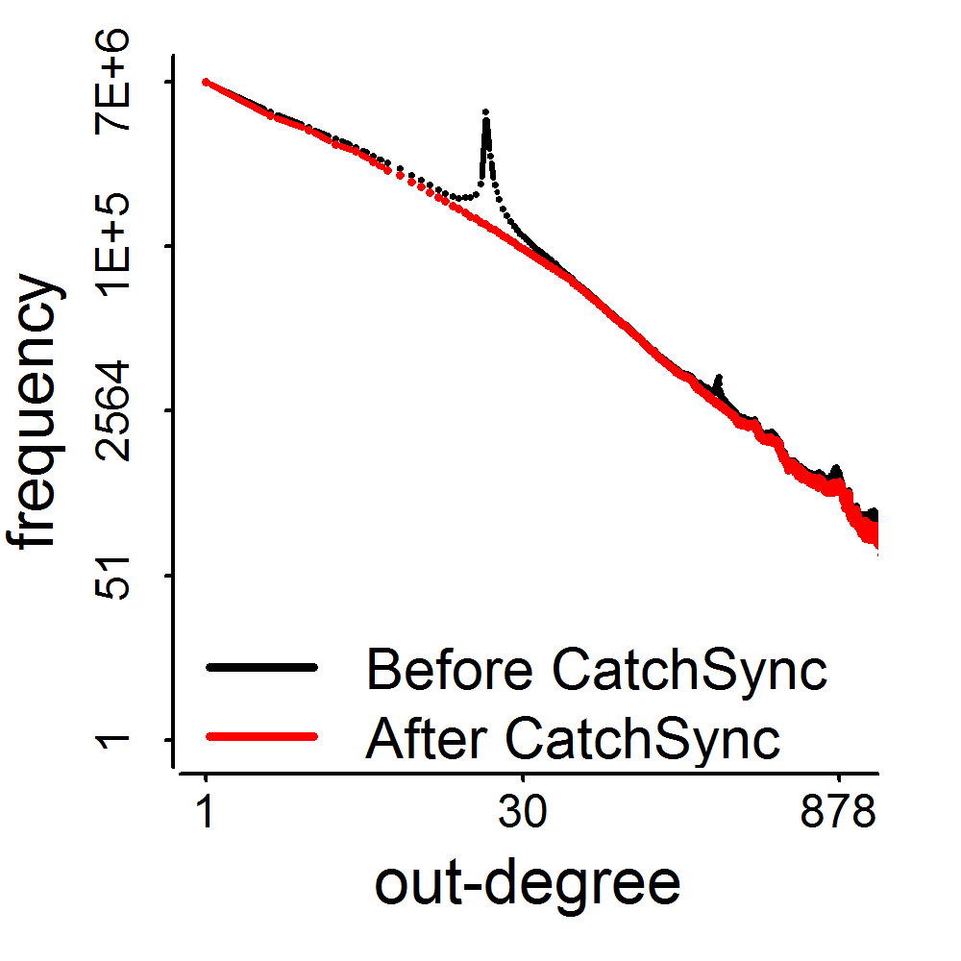
Experimental Results
3.17M
0.41M
d=20

Slide 32
Impact
M. Jiang, P. Cui, A. Beutel, C. Faloutsos and S. Yang. “CatchSync: Catching Synchronized Behavior in Large Directed Graphs” in KDD’14 Best Paper Finalist, Aug 2014. (#citations = 36)
Taught in
CMU 15-826: Multimedia Databases and Data Mining
UMich EECS 598: Graph Mining and Exploration at Scale
ASONAM’16 Tutorial: “Identifying Malicious Actors on Social Media” by S. Kumar, F. Spezzano, V.S. Subrahmanian
Deployed in Weibo? Unfortunately, in July 2014…
Smart enough? First proposed Camouflage in PAKDD’14.
#citations = 26
Cited by KDD’16 Best Research Paper: the authors (B. Hooi et al.) provided theoretical bound to prevent the camouflage.
Notes:
[36] [26]

Slide 33
Roadmap
Toolbox
Behavior prediction
Graph-based outlier detection
Community detection
HITS algorithm
Social contexts
SVD
Graph mining
Intentions
Optimization
Power-law distribution
Suspicious behavior detection

Slide 34
Modeling Spatiotemporal Contexts
Behavior prediction with multi-dimensional data (KDD’14)
Suspicious behavior detection across dimensions (ICDM’15)
t
i
t
i
@user
u
Evolutionary analysis
by Incremental Tensor Decomposition
l
@
u
location
l
@
i
t
user
time
Define a principled suspiciousness metric:
Dimension
Size
Density
Mass
i
1,000 tweets
5 hashtags
i
u
a
t
10 users
t
h
u
a
h
1,000 tweets
Detected 5.94M tweets (582 users, 3 hashtags, 294 IPs, every minute in 40d)
i
5 hashtags
2 IP addr.s
100 users

Slide 35
Roadmap
Toolbox
Behavior prediction
Tensor decompositions
Density-based methods
Evolutionary analysis
KL divergence
Belief propagation
Subgraph mining
Suspicious behavior detection

Slide 36

Roadmap
Toolbox
Ph. D., Tsinghua University, Beijing (2015)
“Modeling Complex Behaviors in Social Media”
Dissertation Award
Behavior prediction
Suspicious behavior detection

Slide 37



Roadmap
Toolbox
T1: Mining behavior networks
with social, spatiotemporal contexts
Information Network
(entities, attributes, relationships)
Structuring
(text mining)
Integration
Rich unstructured text data
Behavior Network
tweets, news, msgs…
u
t
product/restaurant review…
i
l
publications (abstract/full text):
PubMed, dblp, acmdl
a
Structured data
h
@

Slide 38

Roadmap
Toolbox
Worked as Postdoctoral Research Associate
with Prof. Jiawei Han (UIUC) since Aug 2015
Group’s Strength:
Frequent pattern mining (-2003)
Graph pattern mining (-2007)
Mining heterogeneous information network (-2013)
Automatic Text Mining (2014-):
Phrase mining (SegPhrase) [Liu et al. SIGMOD]
Entity recognition and typing [Ren et al.]
Concept hierarchy discovery [Wang et al.; Liu et al.]

Slide 39
Bring Phrases to Behavior Modeling
Tweeting behavior
Event summary
Paper-publishing behavior
Research trend summary
p
p
p
p
p
p
i
t
t
i
a
v
Venue
u
@
@User
Author
a
c
l
h
a
c
Cited paper
Geo-tagged loc.
Hashtag
20:03:09 @ebekahwsm
this better be the best halftime show ever in the history of halftimes shows. ever. #SuperBowl
2009 P. Melville, W. Gryc, R. Lawrence, “Sentiment analysis of blogs by combining lexical knowledge with text classification”, KDD’09. Refs: p81623, p84395…

Slide 40
Tensor Fails
Tweeting behavior
Event summary
Paper-publishing behavior
Research trend summary
p
p
p
p
p
p
i
t
t
i
a
v
u
@
a
c
l
h
a
c
Q: How to represent and summarize dynamic multi-contextual behaviors?
A set of values in dimensions (one-guaranteed value, empty value, multi-values)
summary
(dense block)
✔
❌
❌
location
phrase
user

Slide 41
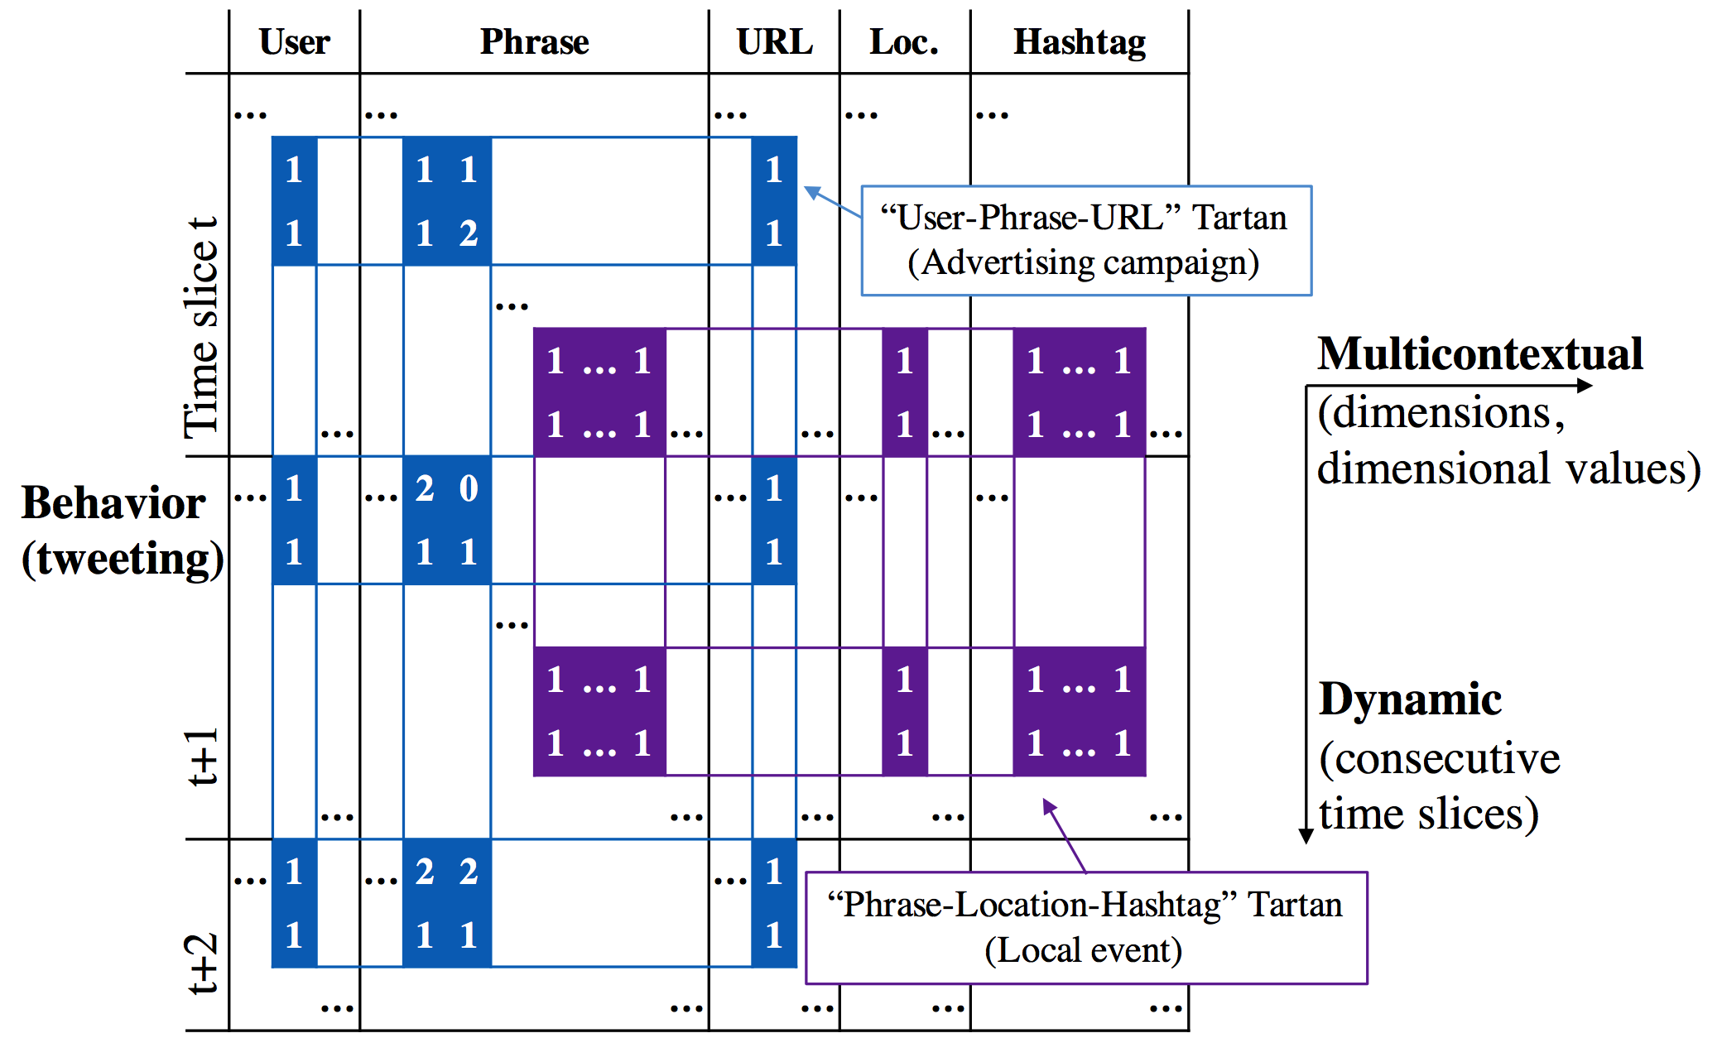
Two-Level Matrix and “Tartan”

Slide 42



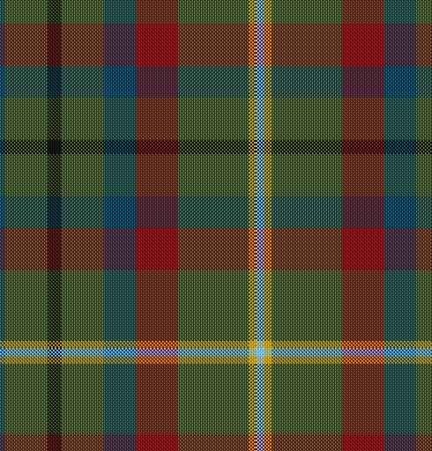


CMU Tartans

Slide 43
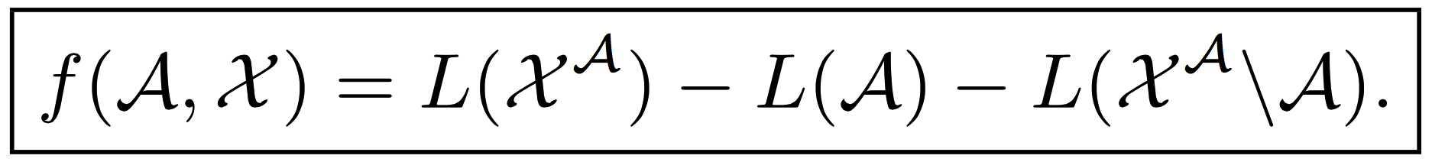
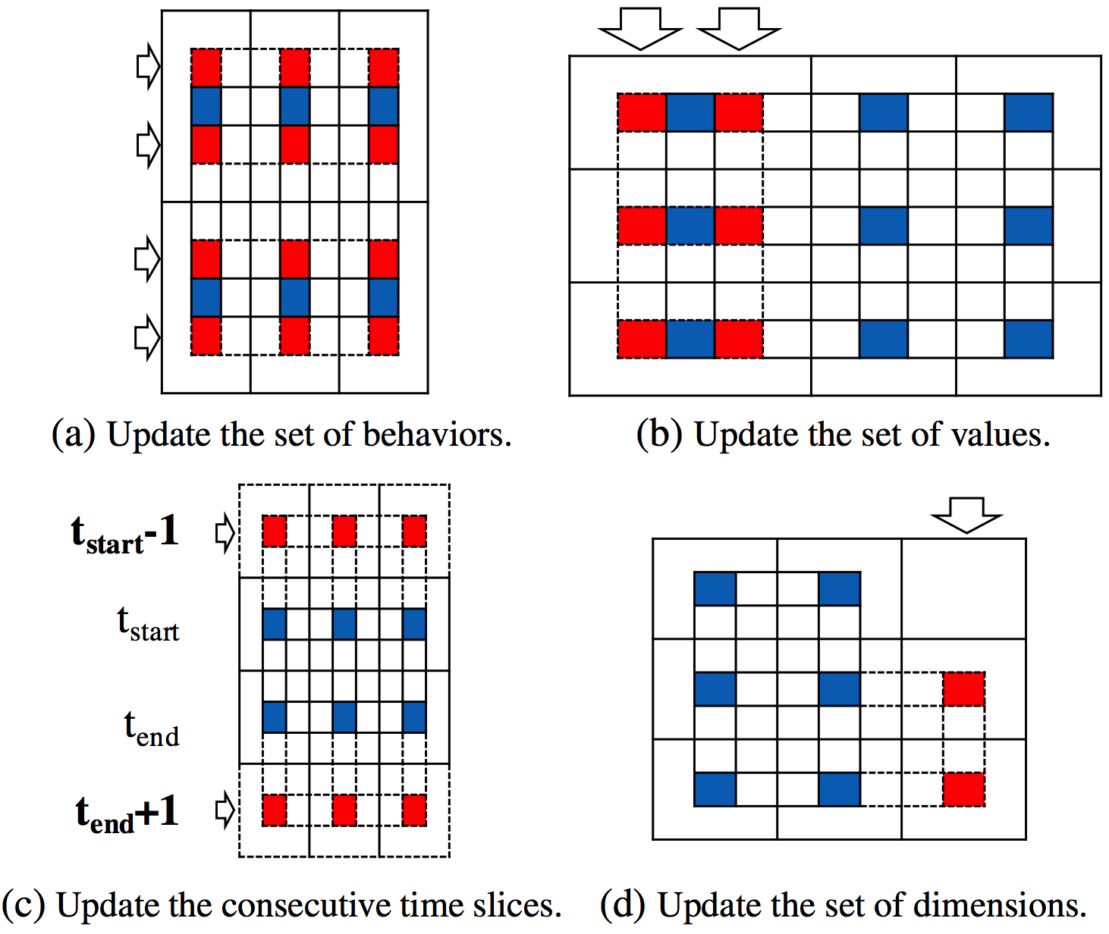
Optimize with MDL Principle
Maximize the number of bits by encoding the Tartan

Slide 44
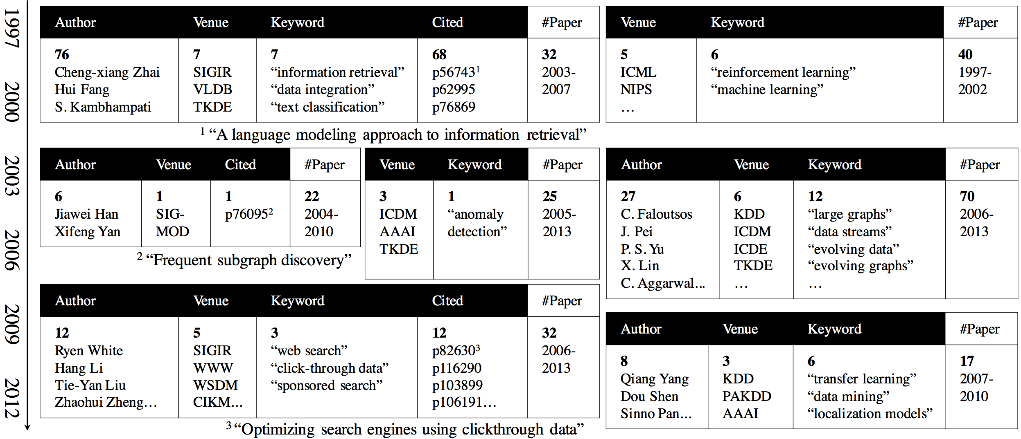
Experimental Results
DM/ML research trend summaries with DBLP data

Slide 45
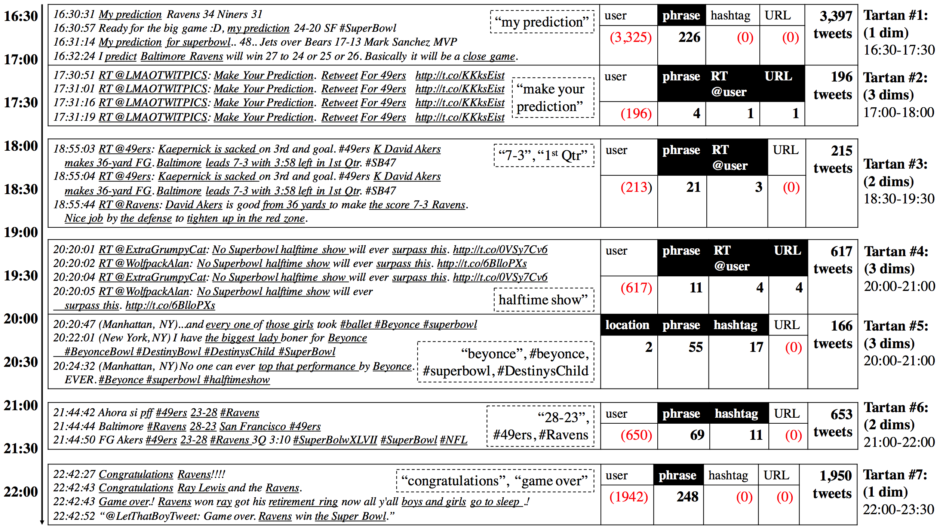
Experimental Results
Event summaries with Super Bowl 2013 tweets

Slide 46
Impact
M. Jiang, C. Faloutsos and J. Han. “CatchTartan: Representing and Summarizing Dynamic Multicontextual Behaviors” in KDD’16 Oral. (Acceptance rate = 8.9%)
The 1st conference paper Prof. Jiawei Han and Prof. Christos Faloutsos co-authored, though they have been predicted to be co-authors for long [Sun et al. ASONAM’11, WSDM’12, KDD’12].
The 9th paper I collaborated with Prof. Christos Faloutsos as the 1st author after my 9-month visit in CMU (2012-2013).
KDD 2016 Rising Stars, Microsoft Research Asia (MSRA) Bing Academic Search.

Slide 47
Roadmap
Toolbox
Representing and summarizing
multi-dimensional (multi-contextual) data
Minimum Description Length principle
Graph summarization
Summarization
Local event detection
Fraud/spam detection
Recommendation
…
Phrasal segmentation
Phrase mining
Grant. “NSF III: Small: Multi-Dimensional Structuring, Summarizing and Mining of Social Media Data”, NSF IIS 16-18481
(08-01-2016 to 07-31-2019, $500,000). Jiawei Han, PI.
Wrote 8/15 pages of the proposal in Oct-Nov 2015.
Major supported member.

Slide 48
Roadmap
Structured Data
Intelligent and Trustworthy Systems
Multidimensional Behavior Network
Behavior Prediction
+
Quality Phrases
Summarization
Unstructured Data
Suspicious Behavior Detection

Slide 49
Roadmap
“You are the one who can integrate behavior networks and information networks!”
Structured Data
Intelligent and Trustworthy Systems
Multidimensional Behavior Network
Behavior Prediction
+
Heterogeneous Information Network
Summarization
Unstructured Data
Suspicious Behavior Detection

Slide 50
Roadmap
T3: Integrating behavior networks with rich information networks: Principles and Models
Data-Driven Behavioral Analytics with Networks
T1: Mining behavior networks
with social, spatiotemporal contexts
T2: Structuring information networks from behavioral content

Slide 51
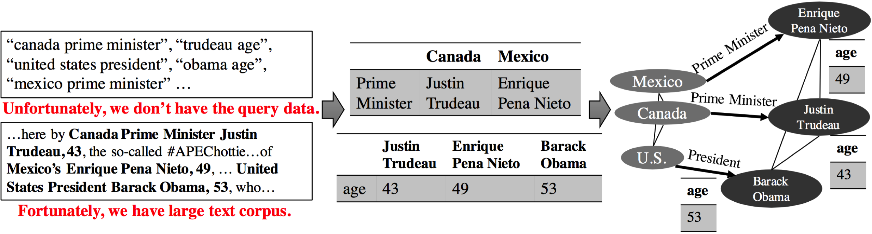
Attributed Network Construction
Automatic Attribute discovery: Given a class (e.g., $Country)
Feature as a characteristic (e.g., “population”)
Value: the feature value (e.g., $Digit or NULL)
Relationship with another class (e.g., “prime minister”)
Value: the other class (e.g., $Person.Politician.PrimeMinister)
Google’s [VLDB’14, WWW’16] based on fact-seeking queries
Challenge 1: (Class, Attribute name, Attribute value)
Challenge 2: Just text documents (news, tweets, etc.). NO query.

Slide 52
Data-Driven: Meta Pattern Mining
Meta Pattern: a sequence of class symbols, words, phrases and punctuation marks that appear contiguously in the text, and serves as a whole semantic unit.
News:
…he’s gotten older and grayer, and he’s been eclipsed at an Asian economic forum here by Canada Prime Minister Justin Trudeau, 43, the so-called #APEChottie… He’s also the youngest leader at the Asia Pacific Economic Cooperation forum, six years the junior of Mexico’s Enrique Pena Nieto, 49, … Obama, 53, who becomes the elder statesman…
1. $Person, $Digit,
2. $Location.Country Prime_Minister $Person.Politician.PrimeMinister
Tweets:
…Protestors march to Gordon Square for 12 -year-old Tamir Rice...
1. protestors march to $Location.Square
2. $Digit -year-old $Person.Victim
PubMed abstract:
… Endocarditis caused by Streptococcus pneumoniae… Pericarditis due to Neisseria meningitidis …
$Cardiovasular_Diseases caused by $Bacteria
$Cardiovasular_Diseases due to $Bacteria

Slide 53
MetaPAD Framework
… Canada Prime Minister Justin Trudeau …
… Barack Obama , 53, …
Integrated Data-Driven Text Mining
Quality phrase mining (SegPhrase, SIGMOD’15)
… Canada Prime_Minister Justin_Trudeau …
… Barack_Obama , 53, …
Meta Pattern Mining
Entity recognition and typing with distant supervision (ClusType, KDD’15)
… $Location Prime_Minister $Person …
… $Person , $Digit , …
Fine-grained typing (PLE, KDD’16)
Attribute Extraction from Meta Patterns
… $Country Prime_Minister $PrimeMinister…
… $President, $Digit , …

Slide 54
MetaPAD Framework
Quality Meta-Pattern Classifier
Integrated Data-Driven Text Mining
Frequency
“prime_minister $PrimeMinister” vs “young $PrimeMinister”
Completeness
“$Country prime_minister $PrimeMinister” vs “$Country prime_minister”
Informativeness
“$Person ’s brother , $Person ,” vs “$Person and $Person”
Coverage
“$Person ’s signature healthcare law”: only “Barack Obama”
Classifier: Random forest
Meta Pattern Mining
Attribute Extraction from Meta Patterns

Slide 55
MetaPAD Framework
…xxx $Country Prime_Minister $PrimeMinister xxx…
…xxx $President , $Digit , xxx…
Integrated Data-Driven Text Mining
Quality Meta-Pattern Classifier
$Location Prime_Minister $Person
$Person, $Digit ,
$Country Prime_Minister $PrimeMinister
$President , $Digit ,
Meta Pattern Mining
Synonym Meta-Pattern Detection
(1) Shared instances (2) J.W. similar words
$Location Prime_Minister $Person
$Location PM $Person
Prime_Minister $Person of $Location
$Person , $Digit ,
$Person , a $Digit -year-old
$Person , age $Digit
Re-typing for Appropriate Granularity
Attribute Extraction from Meta Patterns
$Country Prime_Minister $PrimeMinister
$Person , $Digit ,

Slide 56
Top-Down Re-Typing for Granularity
_____ President _____
LOCATION
79
PERSON
67
_____, a $Digit -year-old
COUNTRY
ETNNICITY
COUNTY
POLITICIAN
59
PERSON
1512
37
29
2
PRESIDENT
PRIMEMINISTER
ATTACKER
ARTIST
ATHLETE
POLITICIAN
VICTIM
58
1
41
Support:
β=29/max(37,29,2)
big (> 0.1), keep $Ethnicity
27
17
31
55
Graininess:
α=(27+17+…+41)/1512
small (< 0.8), stop going down
ORGANZATION
102
PERSON
151
INSTITUTE
SPORTSLEAGUE
POLITICIAN
SCIENTIST
20
3
15
1
Similar for Bottom-Up…

Slide 57
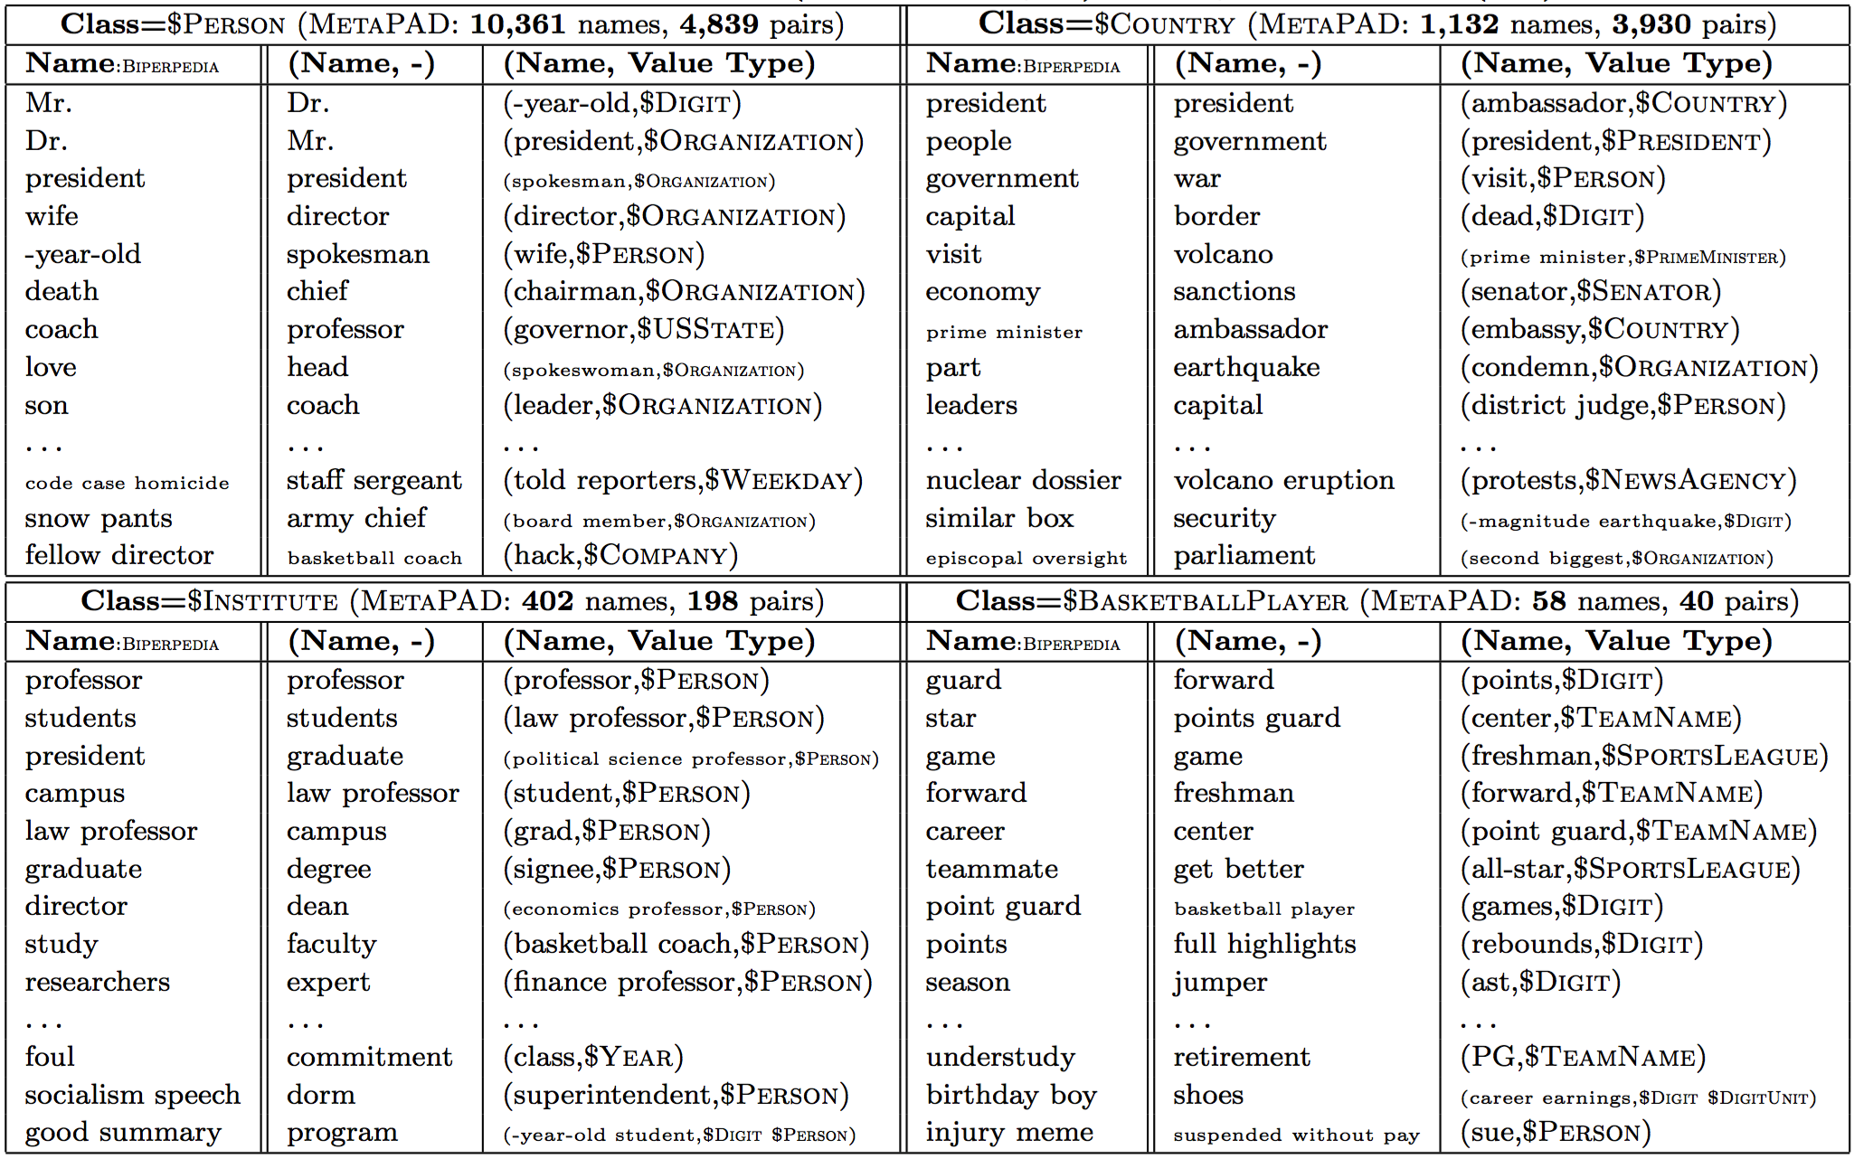
Experimental Results

Slide 58
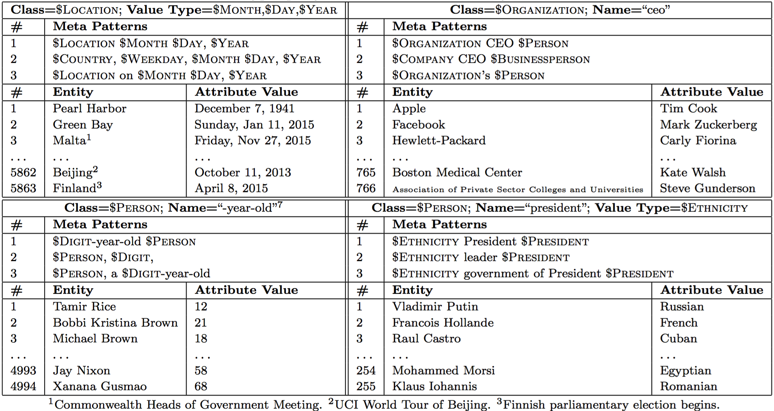
Experimental Results

Slide 59
Experimental Results
F1 score | WPB (’10, 100M) | CNA (’97-’10, 200M) | APR (’15, 200M) | TWT (’15, 1GB)
Total (vs Biperpedia -q) | ↑67.7% | ↑48.3% | ↑189.5% | ↑208.0%
w/ Meta pattern classifier | ↑30.1% | ↑27.0% | ↑127.1% | ↑195.6%
w/ Granularity | ↑20.8% | ↑15.6% | ↑17.3% | ↑3.1%
w/ Integrated text mining techs | ↑13.8% | ↑9.3% | ↑13.0% | ↑0.8%
$Cardiovasular_Diseases due to $Bacteria
$Cardiovasular_Diseases caused by $Bacteria
$Enzymes_and_Coenzymes inhibitor $Chemical
$Chemical | $Enzymes_and_Coenzymes
chelerythrine | protein kinase C
fondaparinux | Factor Xa
calphostin C | protein kinase C
bisindolylmaleimide | protein kinase C
$Bacteria | $Cardiovascular_Diseases
Streptococcus pneumoniae | Endocarditis
Neisseria meningitidis | Pericarditis
Haemophilus paraphrophilus | Endocarditis
Proteus | Endocarditis
Listeria monocytogenes | Pericarditis
Corynebacterium | Endocarditis
Actinomyces | Endocarditis
Coxiella | Endocarditis
Pasteurella pneumotropica | Endocarditis
Cardiobacterium | Endocarditis
$Diagnosis : $Digit +/- $Digit kg/m ( $Digit )
$Diagnosis | $Digit $Digit $Digit
BMI | (31.0 , 6.4 , 2)
BMI | (26 , 4 , 2)
body mass index | (27 , 6 , 2)

Slide 60

Impact
M. Jiang, J. Shang, T. Cassidy (ARL-ALC), L. M. Kaplan (ARL-ALC), T. P. Hanratty (ARL-APG), J. Han. “MetaPAD: Meta Pattern-driven Attribute Discovery in Massive Text Corpora”. Submitted to WSDM 2017.
“This is a milestone work of our group.” – Prof. Jiawei Han
Distant supervision
Data-Driven
Entity recognition
Meta Pattern
Data redundancy
Phrase mining
NLP community
Typing
Attributed information network construction
Structuring tweets, product reviews, papers into networks
Slot filling
Attribute discovery
……

Slide 61
Finding Truth when Structuring
Modeling “source” reliability [Gao et al.]
1
Fulgencio
Batista
($Country, president, $President) : 0.829
2
Meta Pattern | Acc. (FP/P)
$Country ’s President $President | 0.984 (1/61)
President $President of $Country | 1.000 (0/24)
$Country ’s President $President , | 1.000 (0/16)
” $Country President $President | 1.000 (0/7)
… | …
President $President said $Country | 0.833 (1/6)
$Country President $President | 0.807 (16/83)
$Country , President $President | 0.650 (7/20)
$Country - backed President $President | 0.500 (3/6)
$Country under $President | 0.500 (1/2)
$Country – backed
President $President
3
Abd – Rabbu
Mansour Hadi
4
George W
Bush
$Country under
$President
5
Barack
Obama
$Country President
$President
6
Fouad
Massoum
7
Mike
Andres
US
Saudi
Iraq
1. …Fidel Castro and his brother Raul led winning a revolution toppling US - backed President Fulgencio Batista .
2. …control of the country and at reinstating Saudi - backed President Abd - Rabbu Mansour Hadi .
3. …was profoundly forward - leaning and outspoken about the importance of invading Iraq under George W Bush .
7. …better delivering on those expectations , " McDonald 's US President Mike Andres said in the announcement .

Slide 62
Roadmap
Toolbox
Automatic Attributed Information Network Construction with Meta Pattern Mining
Fine-grained typing
Meta Patten
Slot filling
Truth finding
Phrase mining
Entity recognition
Constructing Networks with Trustworthy Information

Slide 63

Roadmap
Conclusion. Data-Driven Behavioral Analytics with Networks
T1: Mining behavior networks with social, spatiotemporal contexts
T2: Structuring information networks from behavioral content
T3: Integrating behavior networks with rich information networks
Toolbox
Structured Data
Intelligent and Trustworthy Systems
Multidimensional Behavior Network
Behavior Prediction
+
Heterogeneous Information Network
Summarization
Unstructured Data
Suspicious Behavior Detection

Slide 64
Future Work
T2 and T3, even T1, are still on the road.
T3: (principles and models) what typing granularity of the information network can improve prediction/detection?
i
Chicago
t
Illinois
u
i
Indiana
 | Granularity | Similarity
item-$Location-item | low | rich
item-$USState-item item-$City-item | high | poor
l
a
h
@

Slide 65
Future Work
T1: (Consulting with behavioral data) behavioral context prediction vs contextual behavior prediction
Contextual behavior prediction
Given all contexts, predict if the behavior will happen
Data mining
WWW
CIKM
KDD
?
M. Jiang
C. Faloutsos
CatchSync
CopyCatch
ContextMF
Tsinghua U
A. Beutel
CMU
Recommendation
Fraud detection
Weibo
Facebook

Slide 66
Future Work
Behavioral context prediction
Suppose the behavior will happen (goal), given partial contexts (resources), find the other critical contexts (strategy)
Data mining
WWW
CIKM
?
KDD
M. Jiang
?
C. Faloutsos
ContextMF
CatchSync
CopyCatch
?
Tsinghua U
A. Beutel
CMU
Recommendation
Fraud detection
Weibo
Facebook

Slide 67
Future Work
Behavioral context prediction
Suppose the behavior will happen (goal), given partial contexts (resources), find the other critical contexts (strategy)
Challenges: unstructured, multi-source, complexity
Data mining
WWW
CIKM
KDD
M. Jiang
C. Faloutsos
ContextMF
CatchSync
CopyCatch
?
Tsinghua U
A. Beutel
?
?
CMU
Recommendation
Fraud detection
Weibo
Facebook

Slide 68

Funding Opportunities
NSF CISE: Information & Intelligent Systems (IIS)
Information Integration and Informatics (III)
Secure and Trustworthy Cyberspace (SaTC)
Faculty Early Career Development Program (CAREER)
U.S. Army Research Laboratory: Network Science Collaborative Technology Alliance (NS CTA)
I1: Constructing Unified, Structured Knowledge Networks by Integrating Text, Social Media and Multi-Genre Networks. (Dr. Lance M. Kaplan and Dr. Taylor Cassidy, ALC)
I4: Distributed, User-Oriented Multi-Scale Network Summarization and Online Analytical Processing. (Dr. Timothy P. Hanratty, Dr. John Richardson and Heather Roy, APG)
International relations (with China): Tencent, Alibaba, etc.

Slide 69
Tutorials, Teaching, Survey, Chapters
ICDM’15 tutorial: M. Jiang and P. Cui. “Behavior Modeling in Social Networks: From Micro to Macro”. (50+ audience, $700 honorarium)
CIKM’16 tutorial: M. Jiang, P. Cui and J. Han. “Data-Driven Behavioral Analytics: Observations, Representations and Models”.
Taught occasionally in CS412 “An Introduction to Data Warehousing and Data Mining”, Fall 2016. Led projects: 3 teams, 24 undergraduates.
Led projects in CS512 “Data Mining: Principles and Algorithms”, Spring 2016: 3 teams, 9 graduates.
TA in Tsinghua: “Streaming Media Technology: Algorithms and Applications” (Fall 2013, 50+ graduates); “An Introduction to Multimedia Technologies” (Spring 2013, 160+ undergraduates).
Invited a Special Issue survey paper in IEEE Intelligent Systems. M. Jiang, P. Cui and C. Faloutsos. “Suspicious Behavior Detection: Current Trends and Future Directions”.
Two book chapters about Behavior Modeling.

Slide 70
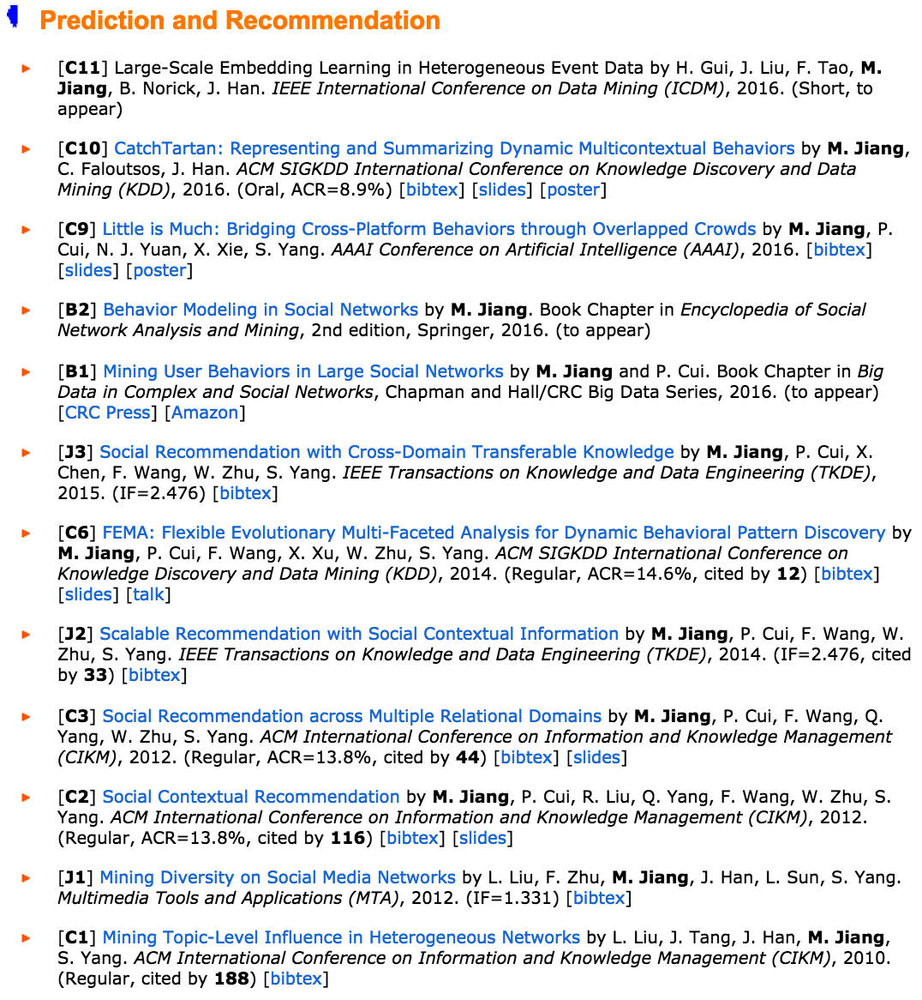
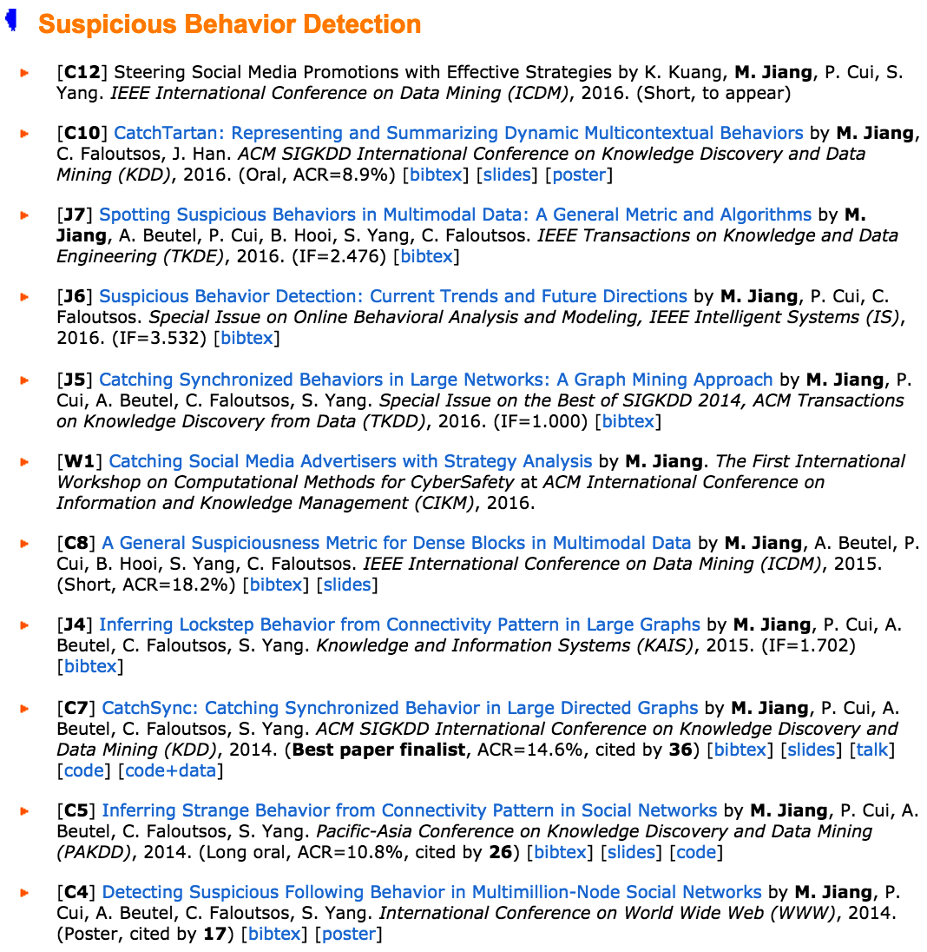
Publications
Google Scholar: #citation=505 (311 as the 1st author), h-index=9
 | Journal | Conference | Chapter | Tutorial
Behavior prediction | 3 (2) | 7 (5) | 2 (2) | 2 (2)
Suspicious behavior detection | 4 (4) | 5 (4)
Total | 7 (6) 3 TKDEs | 12 (9) 3 KDDs | 2 (2) | 2 (2)
Notes:
[505] [311] [9] …

Slide 71
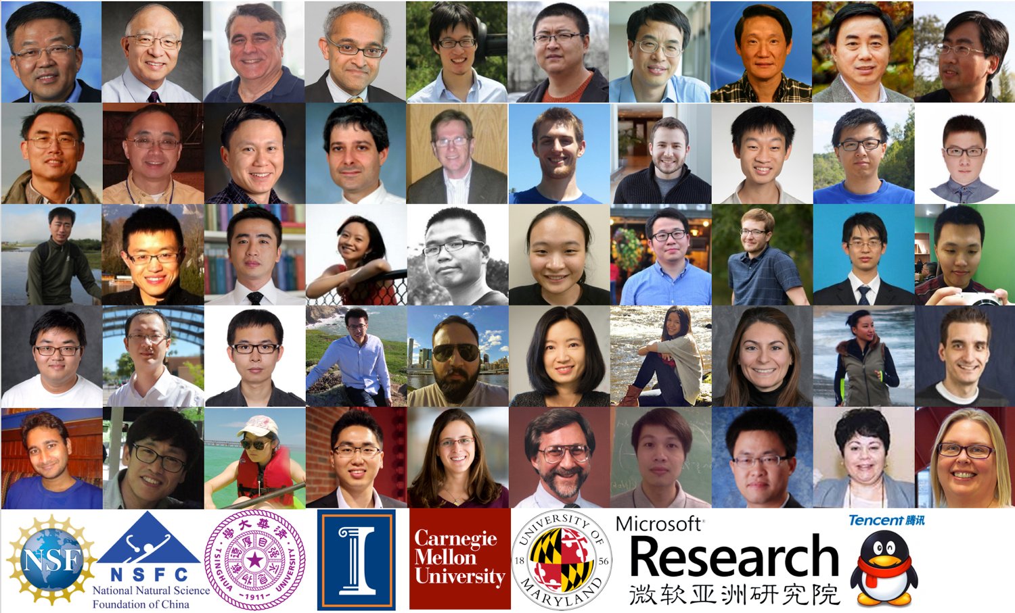
Acknowledgement

Slide 72
References
D. Blei, A. Ng, and M. Jordan. “Latent dirichlet allocation.” JMLR, 2003.
J. Herlocker, J. Konstan, L. Terveen, J. Riedl. “Evaluating collaborative filtering recommender systems.” ACM TOIS, 2004.
Y. Koren, R. Bell, C. Volinsky. “Matrix factorization techniques for recommender systems.” Computer, 2009.
Y. Koren. “Factorization meets the neighborhood: A multifaceted collaborative filtering model.” KDD, 2008.
Y. Koren. “Collaborative filtering with temporal dynamics.” CACM, 2010.
M. Balabanovic and Y. Shoham. “FAB: Content-based, collaborative recommendation.” CACM, 1997.
N. Liu and Q. Yang. “Eigenrank: A ranking-oriented approach to collaborative filtering.” SIGIR, 2008.
N. Liu, M. Zhao, and Q. Yang. “Probabilistic latent preference analysis for collaborative filtering.” CIKM, 2009.

Slide 73
References
H. Ma, H. Yang, M. Lyu, and I. King. “Sorec: Social recommendation using probabilistic matrix factorization.” CIKM, 2008.
H. Ma, T. Zhou, M. Lyu, and I. King. “Improving recommender systems by incorporating social contextual information.” ACM TOIS, 2011.
H. Ma, D. Zhou, C. Liu, M. Lyu, and I. King. “Recommender systems with social regularization.” WSDM, 2011.
J. Leskovec, A. Singh, and J. Kleinberg. “Patterns of influence in a recommendation network.” PAKDD, 2006.
P. Massa and A. Paolo. “Trust-aware recommender systems.” RecSys, 2007.
M. Jamali and E. Martin. “TrustWalker: A random walk model for combining trust-based and item-based recommendation.” KDD, 2009.
H. Ma, I. King, and M. Lyu. “Learning to recommend with social trust ensemble.” SIGIR, 2009.
H. Ma. I. King, and M. Lyu. “Learning to recommend with explicit and implicit social relations.” ACM TIST, 2011.

Slide 74
References
M. Faloutsos, P. Faloutsos, and C. Faloutsos. “On power-law relationships of the internet topology.” SIGCOMM, 1999.
A. Broder, R. Kumar, F. Maghoul, P. Raghavan, S. Rajagopalan, R. Stata, A. Tomkins, and J. Weiner. “Graph structure in the web.” Computer Networks, 2000.
F. Chung and L. Lu. “The average distances in random graphs with given expected degrees.” PNAS, 2002.
J. Kleinberg. “Authoritative sources in a hyperlinked environment.” JACM, 1999.
H. Kwak, C. Lee, H. Park, and S. Moon. “What is Twitter, a social network or a news media?” WWW, 2010.
B. Hooi, H.A. Song, A. Beutel, N. Shah, K. Shin, and C. Faloutsos. “Fraudar: Bounding graph fraud in the face of camouflage.” KDD, 2016.
C. Aggarwal and J. Han. “Frequent pattern mining.” Springer, 2014.
J. Han, J. Pei, B. Mortazavi-Asl, Q. Chen, U. Dayal, and M. Hsu. “FreeSpan: Frequent pattern-projected sequential pattern mining.” KDD, 2000.

Slide 75
References
X. Yan and J. Han. “gspan: Graph-based substructure pattern mining.” ICDM, 2003.
X. Yan and J. Han. “CloseGraph: Mining closed frequent graph patterns.” KDD, 2003.
Y. Sun, J. Han, X. Yan, P.S. Yu, and T. Wu. “PathSim: Meta path-based top-k similarity search in heterogeneous information networks.” VLDB, 2011.
Y. Sun, Y. Yu, and J. Han. “Ranking-based clustering of heterogeneous information networks with star network schema.” KDD, 2009.
Y. Sun, J. Han, P. Zhao, Z. Yin, H. Cheng, and T. Wu. “RankClus: Integrating clustering with ranking for heterogeneous information network analysis.” EDBT, 2009.
Y. Sun, R. Barber, M. Gupta, C. Aggarwar, and J. Han. “Co-author relationship prediction in heterogeneous bibliographic networks.” ASONAM, 2011.
A. El-Kishky, Y. Song, C. Wang, C.R. Voss, and J. Han. “Scalable topical phrase mining from text corpora.” VLDB, 2014.
J. Liu, J. Shang, C. Wang, X. Ren, and J. Han. “Mining quality phrases from massive text corpora.” SIGMOD, 2015.

Slide 76
References
X. Ren, A. El-Kishky, C. Wang, F. Tao, C.R. Voss, and J. Han. “Effective entity recognition and typing by relation phrase-based clustering.” KDD, 2015.
X. Ren, W. He, M. Qu, C.R. Voss, H. Ji, and J. Han. “Label noise reduction in entity typing by heterogeneous partial-label embedding.” KDD, 2016.
C. Wang, M. Danilevsky, N. Desai, Y. Zhang, P. Nguyen, T. Taula, and J. Han. “A phrase mining framework for recursive construction of a topical hierarchy.” KDD, 2013.
E.E. Papalexakis, C. Faloutsos, N.D. Sidiropoulos. “ParCube: Sparse parallelizable tensor decompositions.” PKDD, 2012.
D. Koutra, U. Kang, J. Vreeken, and C. Faloutsos. “VOG: Summarizing and understanding large graphs.” SDM, 2014.
R. Gupta, A. Halevy, X. Wang, S.E. Whang, and F. Wu. “Biperpedia: An ontology for search applications.” VLDB, 2014.
M. Yahya, S. Whang, R. Gupta, and A. Halevy. “ReNoun: Fact extraction for nominal attributes.” EMNLP, 2014.
A. Halevy, N. Noy, S. Sarawagi, S.E. Whang, and X. Yu. “Discovering structure in the universe of attribute names.” WWW, 2016.

Slide 77
References
Q. Li, Y. Li, J. Gao, B. Zhao, W. Fan, and J. Han. “Resolving conflicts in heterogeneous data by truth discovery and source reliability estimation.” SIGMOD, 2014.
Q. Li, Y. Li, J. Gao, L. Su, B. Zhao, M. Demirbas, W. Fan, and J. Han. “A confidence-aware approach for truth discovery on long-tail data.” VLDB, 2014.
F. Ma, Y. Li, Q. Li, M. Qiu, J. Gao, S. Zhi, L. Su, B. Zhao, H. Ji, and J. Han. “Faitcrowd: Fine grained truth discovery for crowdsourced data aggregation.” KDD, 2015.
Y. Li, J. Gao, C. Meng, Q. Li, L. Su, B. Zhao, W. Fan, and J. Han. “A survey on truth discovery.” KDD Explorations Newsletter, 2016.
S. Zhi, B. Zhao, W. Tong, J. Gao, D. Yu, H. Ji, and J. Han. “Modeling truth existence in truth discovery.” KDD, 2015.
S. Kumar, R. West, and J. Leskovec. “Disinformation on the Web: Impact, characteristics, and detection of Wikipedia hoaxes.” WWW, 2016.
S. Kumar, F. Spezzano, and V.S. Subrahmanian. “Identifying malicious actors on social media.” ASONAM, 2016. (tutorial)

Slide 78
Thank you!
Data-Driven Behavioral Analytics with Networks
Meng Jiang
www.meng-jiang.com

Slide 79
Notes:
[x]

Slide 80
Notes:
[x]

